Slide 1

LAB MEETING
바이오메디컬공학부
201715447
김준형

Slide 2
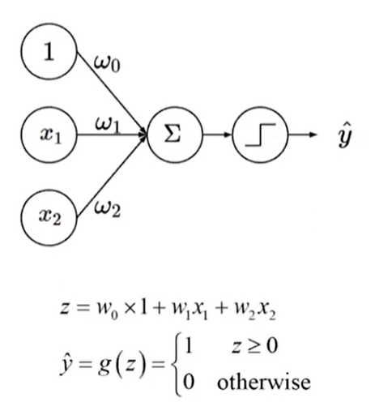
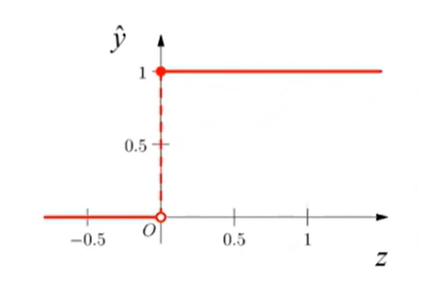
● 1. ANN (Artificial Neural Network)
Multi-layer perceptron(MLP) = Artificial Neural Networks(ANN)

Slide 3
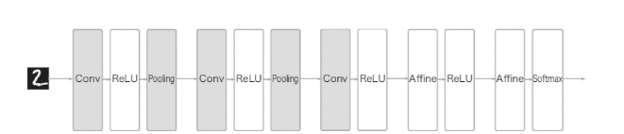
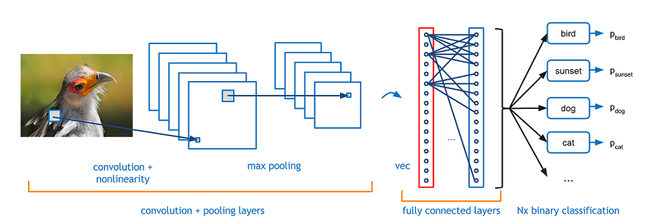
● 2. CNN (Convolution Neural Network)

Slide 4
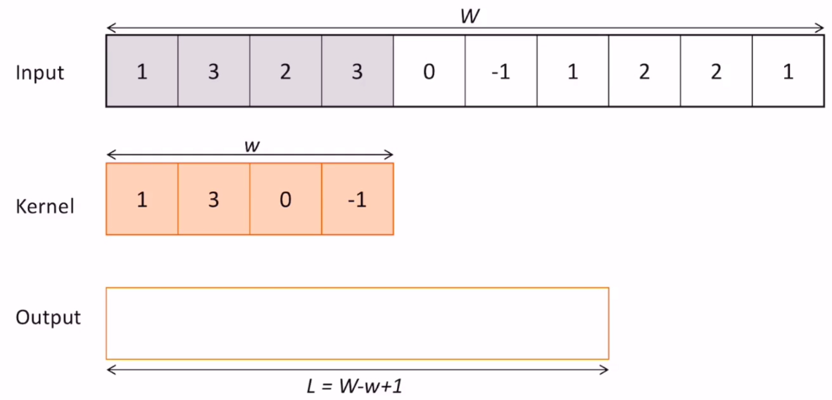
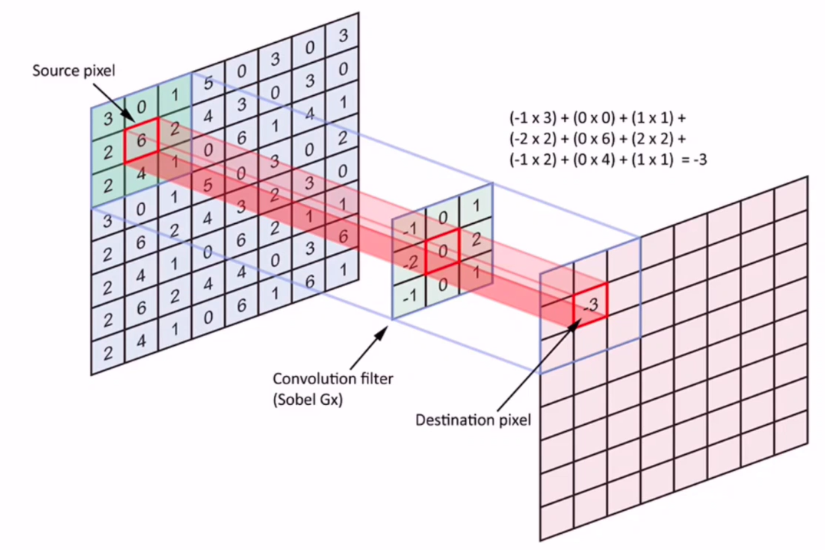
● 2. CNN (Convolution Neural Network)

